Slide 1

Advanced Machine Learning Techniques
Session - 4

Slide 2
Advanced MLT – Course overview
Dimensionality reduction
Principal Component Analysis
Linear Discriminant Analysis , Locally Linear Embedding
T - Distributed Stochastic Neighbour Embedding
Clustering and Mixture models
Machine Learning Project Life Cycle
ML deployment
Deployment using FastAPI and cloud platforms

Slide 3
Clustering algos
Partition based (Eg: K Means)
Density based(DBSCAN)
Hierarchical(Agglomerative/divisive)
Model based (Gaussian Mixture models)

Slide 4
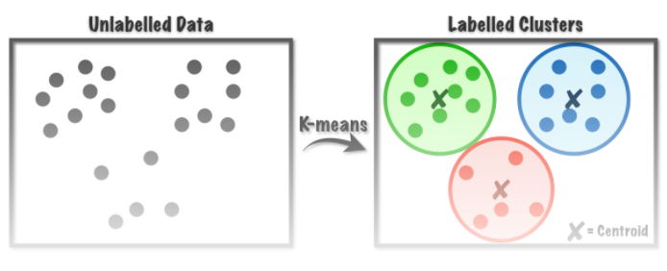
Clustering algos
Partition based (Eg: K Means)
Density based(DBSCAN)
Hierarchical(Agglomerative/divisive)
Model based (Gaussian Mixture models)

Slide 5
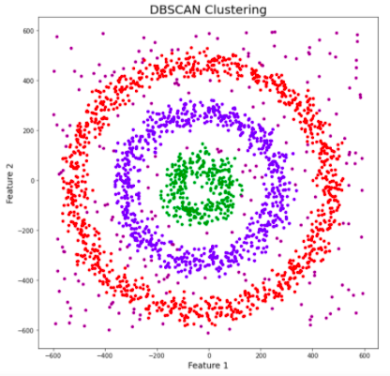
Clustering algos
Partition based (Eg: K Means)
Density based(DBSCAN)
Hierarchical(Agglomerative/divisive)
Model based (Gaussian Mixture models)

Slide 6
Hierarchical clustering Agenda
Introduction
Example
Process
Theory
Implementation

Slide 7
Example: Customer
Cust_ID | Prod Price | Prod Price | ……. | Prod Price | Prod Price
1
2
3
4
..
--
--
--
10000
Segmentation. ?

Slide 8
Example: Customer
Cust_ID | Prod_Price
1 | 10
2 | 7
3 | 28
4 | 20
5 | 35

Slide 9
Affinity matrix
Cust_ID | Prod Price
1 | 10
2 | 7
3 | 28
4 | 20
5 | 35
ID | 1 | 2 | 3 | 4 | 5
1
2
3
4
5

Slide 10
Affinity matrix
Cust_ID | Prod Price
1 | 10
2 | 7
3 | 28
4 | 20
5 | 35
ID | 1 | 2 | 3 | 4 | 5
1 | 0
2 |  | 0
3 |  |  | 0
4 |  |  |  | 0
5 |  |  |  |  | 0

Slide 11
Affinity matrix
Cust_ID | Prod_ Price
1 | 10
2 | 7
3 | 28
4 | 20
5 | 35
ID | 1 | 2 | 3 | 4 | 5
1 | 0 | 3 | 18 | 10 | 25
2 | 3 | 0
3 | 18 |  | 0
4 | 10 |  |  | 0
5 | 25 |  |  |  | 0
Affinity: Distance

Slide 12
Affinity matrix
Cust_ID | Prod Price
1 | 10
2 | 7
3 | 28
4 | 20
5 | 35
ID | 1 | 2 | 3 | 4 | 5
1 | 0 | 3 | 18 | 10 | 25
2 | 3 | 0 | 21 | 13 | 28
3 | 18 | 21 | 0
4 | 10 | 13 |  | 0
5 | 25 | 28 |  |  | 0

Slide 13
Affinity matrix
Cust_ID | Prod_ Price
1 | 10
2 | 7
3 | 28
4 | 20
5 | 35
ID | 1 | 2 | 3 | 4 | 5
1 | 0 | 3 | 18 | 10 | 25
2 | 3 | 0 | 21 | 13 | 28
3 | 18 | 21 | 0 | 8 | 7
4 | 10 | 13 | 8 | 0
5 | 25 | 28 | 7 |  | 0

Slide 14
Affinity matrix
Cust_ID | Prod Price
1 | 10
2 | 7
3 | 28
4 | 20
5 | 35
ID | 1 | 2 | 3 | 4 | 5
1 | 0 | 3 | 18 | 10 | 25
2 | 3 | 0 | 21 | 13 | 28
3 | 18 | 21 | 0 | 8 | 7
4 | 10 | 13 | 8 | 0 | 15
5 | 25 | 28 | 7 | 15 | 0

Slide 15
Affinity matrix
Cust_ID | Prod Price
1 | 10
2 | 7
3 | 28
4 | 20
5 | 35
ID | 1 | 2 | 3 | 4 | 5
1 | 0
2 | 3 | 0
3 | 18 | 21 | 0
4 | 10 | 13 | 8 | 0
5 | 25 | 28 | 7 | 15 | 0

Slide 16
Affinity matrix
ID | 1 | 2 | 3 | 4 | 5
1 | 0
2 | 3 | 0
3 | 18 | 21 | 0
4 | 10 | 13 | 8 | 0
5 | 25 | 28 | 7 | 15 | 0
Choose the smallest value

Slide 17
Affinity matrix
ID | 1 | 2 | 3 | 4 | 5
1 | 0
2 | 3 | 0
3 | 18 | 21 | 0
4 | 10 | 13 | 8 | 0
5 | 25 | 28 | 7 | 15 | 0
Cust_ID | Prod Price
12 | 10 (=max(7,10))
3 | 28
4 | 20
5 | 35
ID | 12 | 3 | 4 | 5
12 | 0
3 |  | 0
4 |  |  | 0
5 |  |  |  | 0

Slide 18
Affinity matrix
Cust_ID | Prod Price
12 | 10
3 | 28
4 | 20
5 | 35
ID | 1 | 2 | 3 | 4 | 5
1 | 0
2 | 3 | 0
3 | 18 | 21 | 0
4 | 10 | 13 | 8 | 0
5 | 25 | 28 | 7 | 15 | 0
ID | 12 | 3 | 4 | 5
12 | 0 | 18 | 10 | 25
3 | 18 | 0 | 8 | 7
4 | 10 | 8 | 0 | 15
5 | 25 | 7 | 15 | 0

Slide 19
Affinity matrix
ID | 12 | 3 | 4 | 5
12 | 0
3 | 18 | 0
4 | 10 | 8 | 0
5 | 25 | 7 | 15 | 0

Slide 20
Affinity matrix
ID | 12 | 3 | 4 | 5
12 | 0
3 | 18 | 0
4 | 10 | 8 | 0
5 | 25 | 7 | 15 | 0

Slide 21
Affinity matrix
ID | 12 | 3 | 4 | 5
12 | 0
3 | 18 | 0
4 | 10 | 8 | 0
5 | 25 | 7 | 15 | 0
Cust_ID | Prod Pricet
12 | 10 (=max(7,10))
35
4

Slide 22
Affinity matrix
ID | 12 | 3 | 4 | 5
12 | 0
3 | 18 | 0
4 | 10 | 8 | 0
5 | 25 | 7 | 15 | 0
Cust_ID | Prod Price
12 | 10 (=max(7,10))
35 | 35= max(28,35)
4 | 20

Slide 23
Affinity matrix
Cust_ID | Prod Price
12 | 10
35 | 35
4 | 20
ID | 12 | 35 | 4
12 | 0 | 25 | 10
35 | 25 | 0 | 15
4 | 10 | 15 | 0

Slide 24
Affinity matrix
ID | 12 | 35 | 4
12 | 0
35 | 25 | 0
4 | 10 | 15 | 0

Slide 25
Affinity matrix
ID | 12 | 35 | 4
12 | 0
35 | 25 | 0
4 | 10 | 15 | 0
Cust_ID | Prod Price
124 | 20 (=max(10,20))
35 | 35

Slide 26
Cust_ID | 12435
12435 | 15

Slide 27
Sample | (12) | (35) | (12)4 | (12)4(35)
Distance | 3 | 7 | 10 | 15

Slide 28
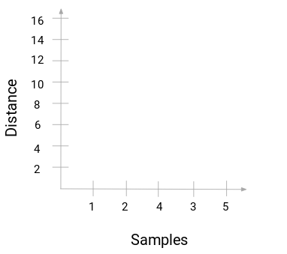
Dendrogram
Sample | (12) | (35) | (12)4 | (12)4(35)
Distance | 3 | 7 | 10 | 15

Slide 29
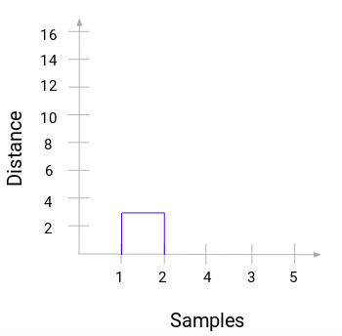
Dendrogram
Sample | (12) | (35) | (12)4 | (12)4(35)
Distance | 3 | 7 | 10 | 15

Slide 30
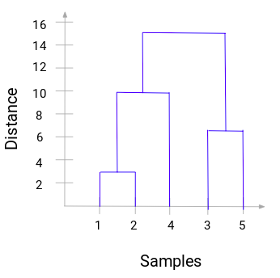
Dendrogram
Sample | (12) | (35) | (12)4 | (12)4(35)
Distance | 3 | 7 | 10 | 15

Slide 31
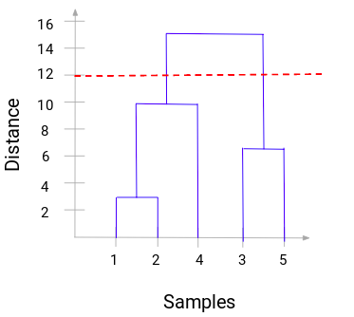
Dendrogram

Slide 32
Linkages
Maximum/Complete: Maximum distance between all observations between the sets.
Average: Average distance between all observations between the sets.
Single: Minimum distance between all observations between the sets.
Ward: Minimises the variance of the clusters being merged.

Slide 33
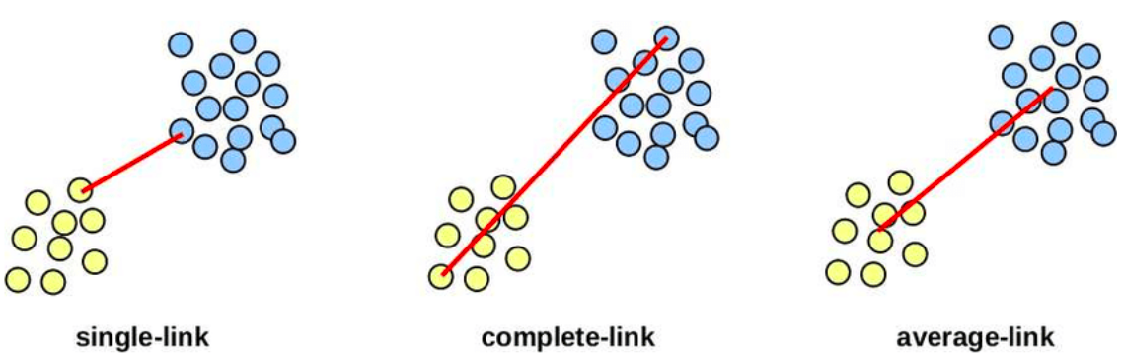
Linkages

Slide 34
Affinity
Euclidean
Manhattan
Cosine

